Slide 1
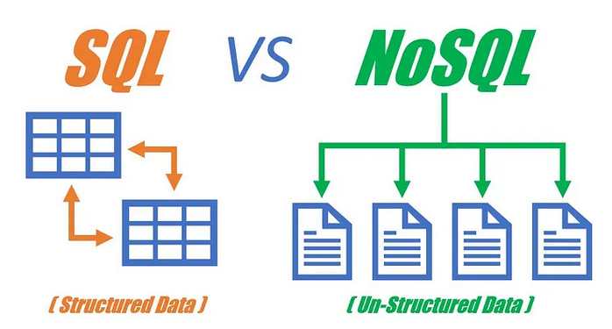
NoSQL DATABASES: What are they
NoSQL stands for „Not Only SQL“
Category of database systems
SQL = Structured, relational, used for querying and manipulating data
noSQL = Designed to handle unstructured, semi-structured, or highly variable data

Slide 2
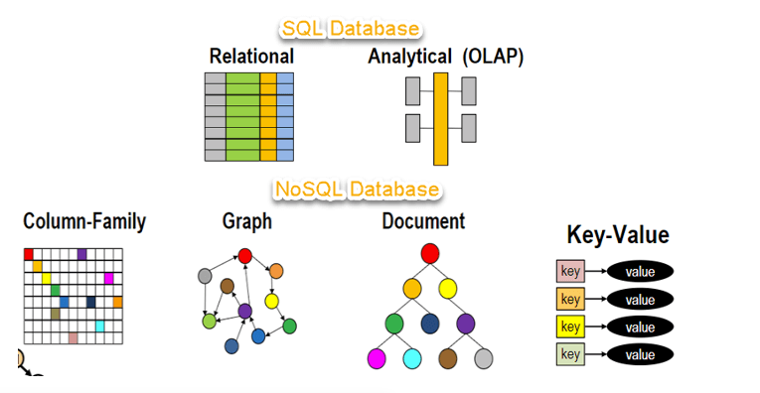
Types
Document-oriented databases: Store and retrieve data in the form of documents.
Key-value stores: Data is stored as key-value pairs, where each key is unique and maps to a specific value.
Column-family stores: Data is stored in columns rather than rows, and these columns can be grouped together into families.
Graph databases: Designed for storing and querying data with complex relationships. Graph databases use nodes, edges, and properties to represent and store data.

Slide 3
